Slide 1
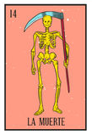

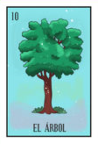
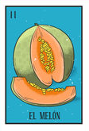
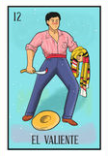
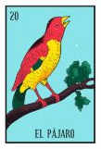
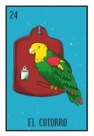
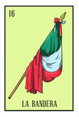

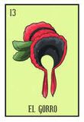
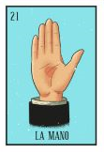
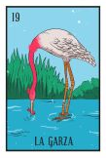
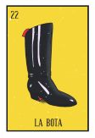
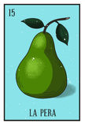
LOTERIA GAME
Just as in the traditional game, we have a multiplayer Loteria.
You can get into the site, register as a player and start having fun.
But you need to pay attention to the random cards and to your card board, click on the card in your grid if it matches to the random card and put a bean on it.
The firs player full filling the card board, is the absolute winner.
The overall concept of the application

Slide 2
LOTERIA GAME
Have some fun!
No need to have physical cardboars, which are actually limited if you buy a “real” lotería game.
Promote mexican culture.
Your motivation for developing the application

Slide 3
LOTERIA GAME
1. Brainstorm & defining the objectives
2. Establishing the logic of the app, pseudocoding and design of the layout. Making decision on which technology use.
3. Creating the Project: initial files and the KanBan Board in GitHub, dividing the Project and assigning tasks.
4. Coding process (Building ↔ Testing ↔ Identifying and correcting bugs ↔ Having problems with GitHub)
5. Going live & Present Project.
Your design process

Slide 4
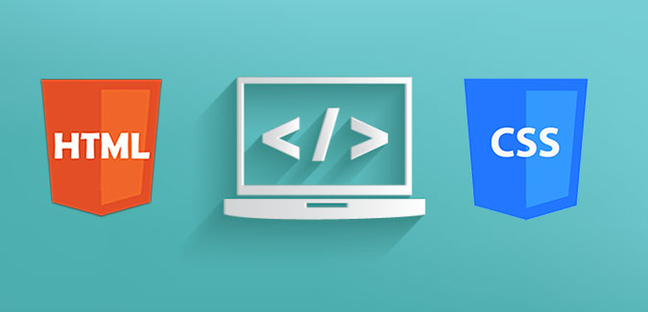
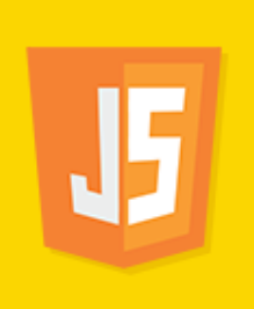




LOTERIA GAME
Storage players & their progress
API’s
Design & Layout
Events
Technologies used and how they work

Slide 5
LOTERIA GAME
DEMO!!
(por fi añadir el link al Proyecto)
The overall concept of the application

Slide 6
LOTERIA GAME
The logic & design of the game could be used for educational purposes in a fun way.
Directions for future development

